Slide 1
Introduction to Shiny
PsyTeachR Shiny Tutorials
https://psyteachr.github.io/shiny-tutorials/

Slide 2

What is Shiny?
R package that allows you to create interactive GUIs in R
Highly flexible and customisable
Applications
Intuitive tools for science
Presenting results
Collecting data
Teaching

Slide 3
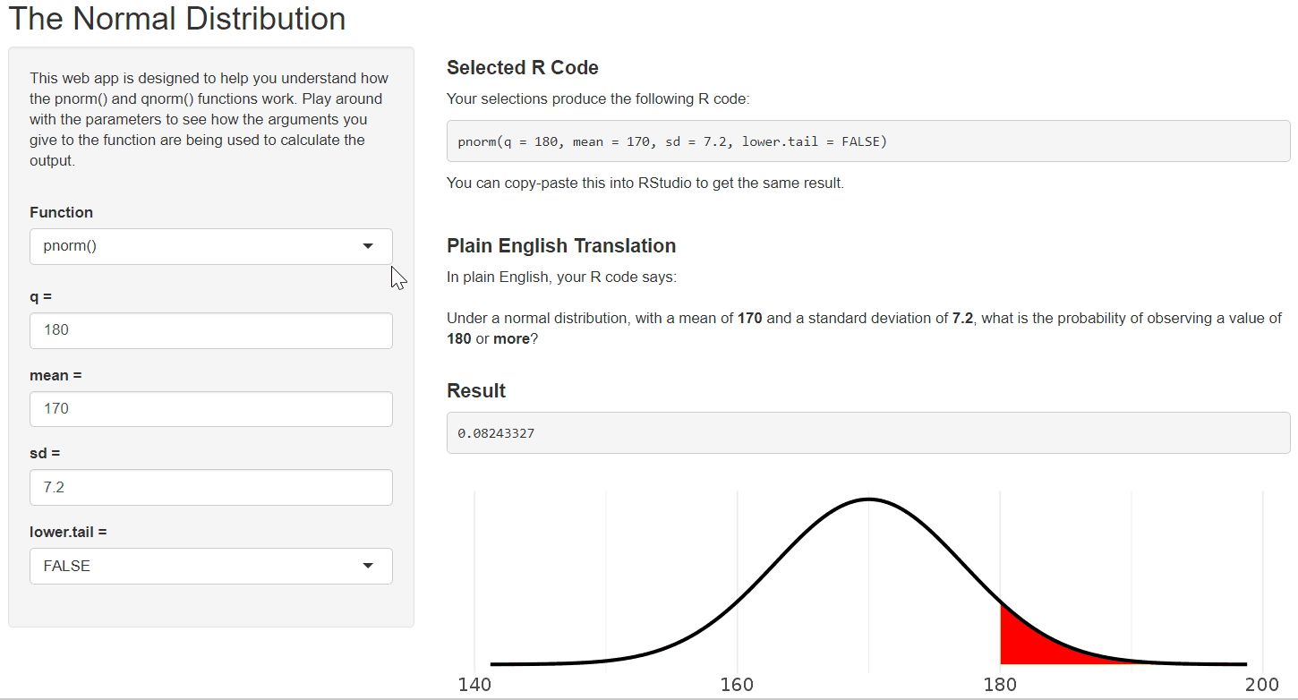
http://shiny.psy.gla.ac.uk/ShinyPsyTeachR/ug1/normal-distributions/

Slide 4
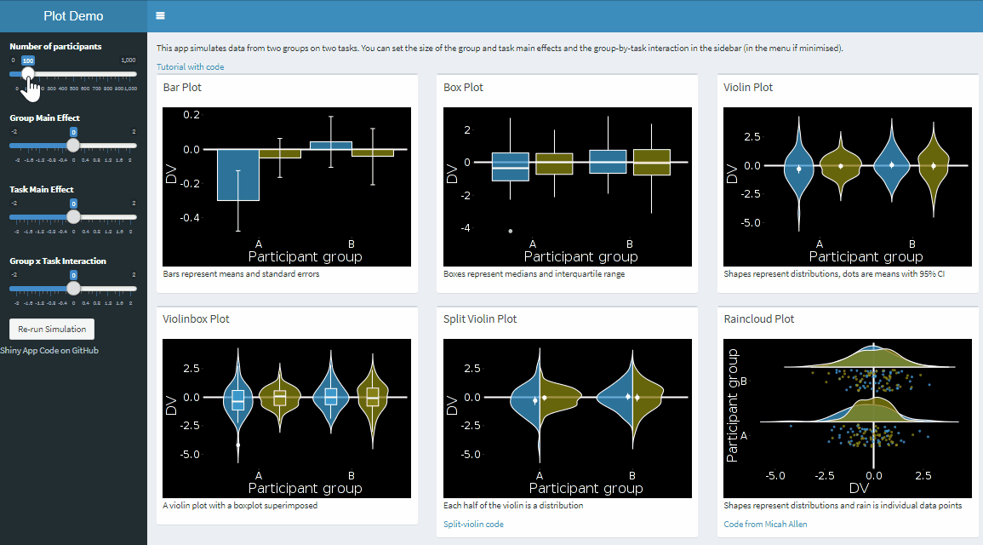
http://shiny.psy.gla.ac.uk/debruine/plotdemo/

Slide 5
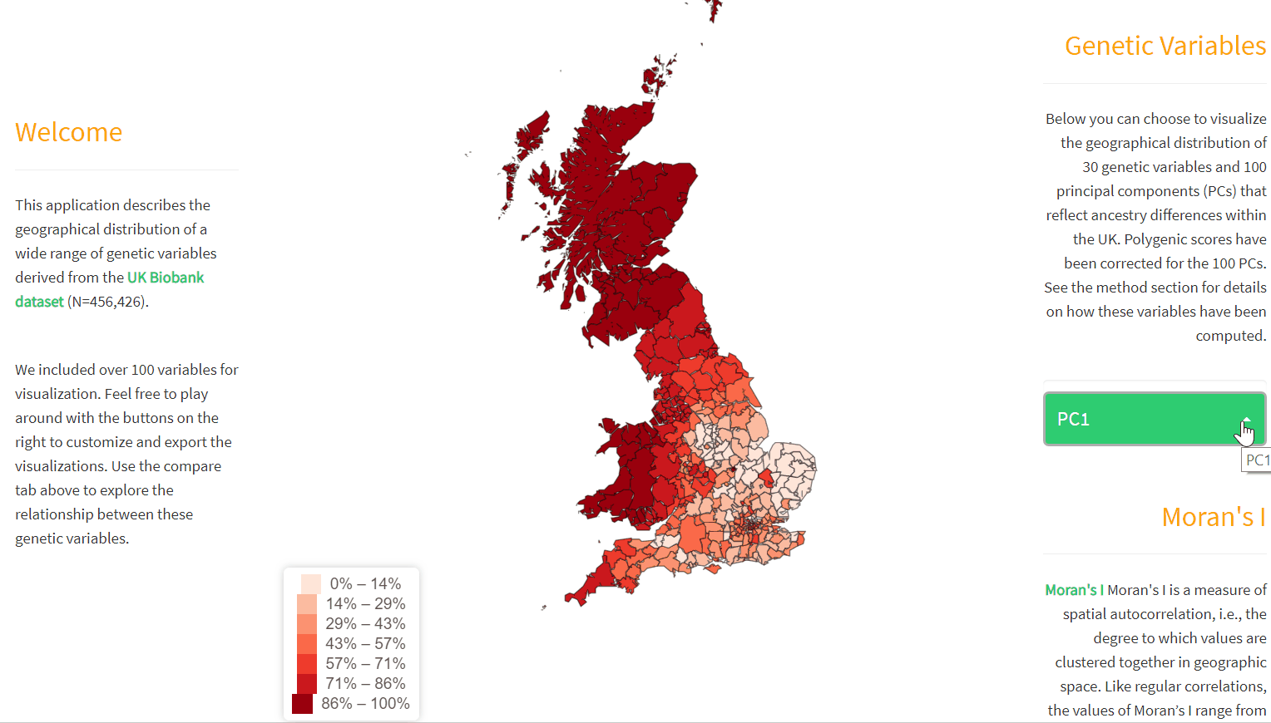
https://holtzyan.shinyapps.io/UKB_geo/

Slide 6
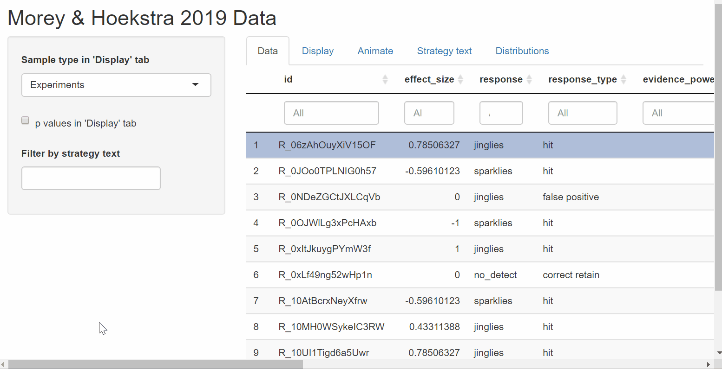
https://richarddmorey.github.io/Morey_Hoekstra_StatCognition/index.html

Slide 7
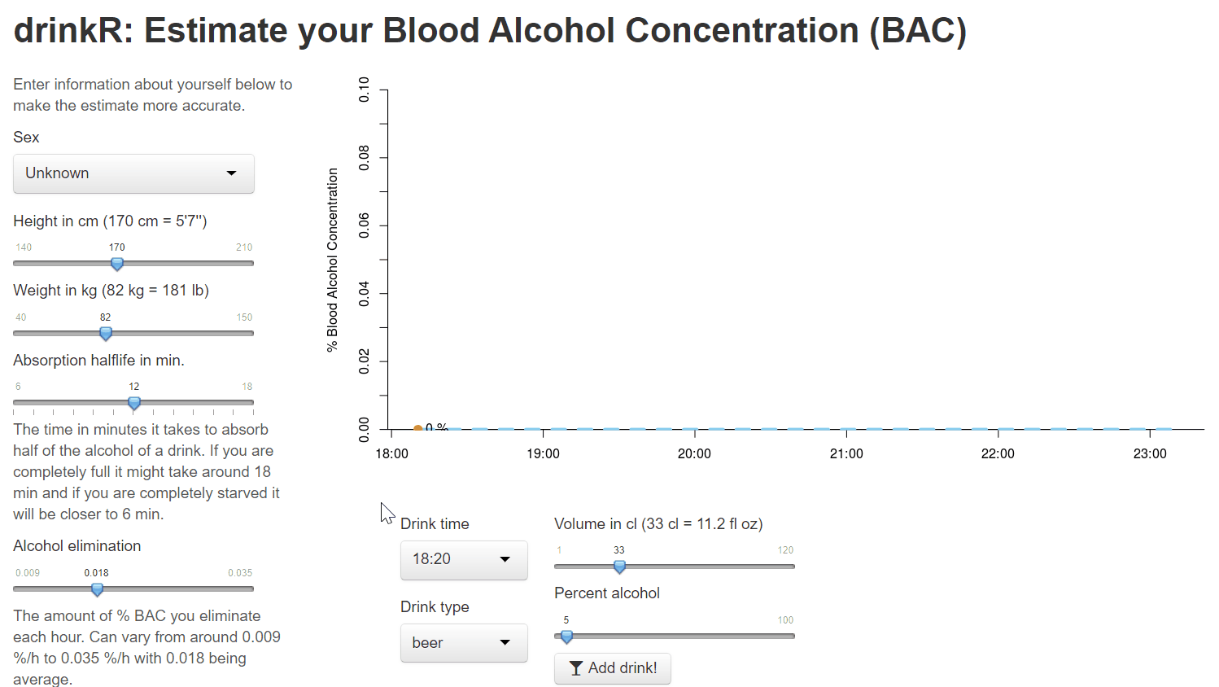
https://gallery.shinyapps.io/drinkr/

Slide 8
How does Shiny work?
ui
server
Runs once
Specifies the user interface
Defined as an object
Stable and unchanging
Runs continually
Specifies the logic
Defined as a function
Can change in response to input

Slide 9
Old Faithful Example - ui
# Define UI for application that draws a histogram
ui <- fluidPage(
# Application title
titlePanel("Old Faithful Geyser Data"),
# Sidebar with a slider input for number of bins
sidebarLayout(
sidebarPanel(
sliderInput("bins",
"Number of bins:",
min = 1,
max = 50,
value = 30)
),
# Show a plot of the generated distribution
mainPanel(
plotOutput("distPlot")
)
)
)

Slide 10
Old Faithful Example - ui
# Define UI for application that draws a histogram
ui <- fluidPage(
# Application title
titlePanel("Old Faithful Geyser Data"),
# Sidebar with a slider input for number of bins
sidebarLayout(
sidebarPanel(
sliderInput("bins",
"Number of bins:",
min = 1,
max = 50,
value = 30)
),
# Show a plot of the generated distribution
mainPanel(
plotOutput("distPlot")
)
)
)

Slide 11
Old Faithful Example - server
# Define server logic required to draw a histogram
server <- function(input, output) {
output$distPlot <- renderPlot({
# generate bins based on input$bins from ui.R
x <- faithful[, 2]
bins <- seq(min(x), max(x), length.out = input$bins + 1)
# draw the histogram with the specified number of bins
hist(x, breaks = bins, col = 'darkgray', border = 'white')
})
}

Slide 12
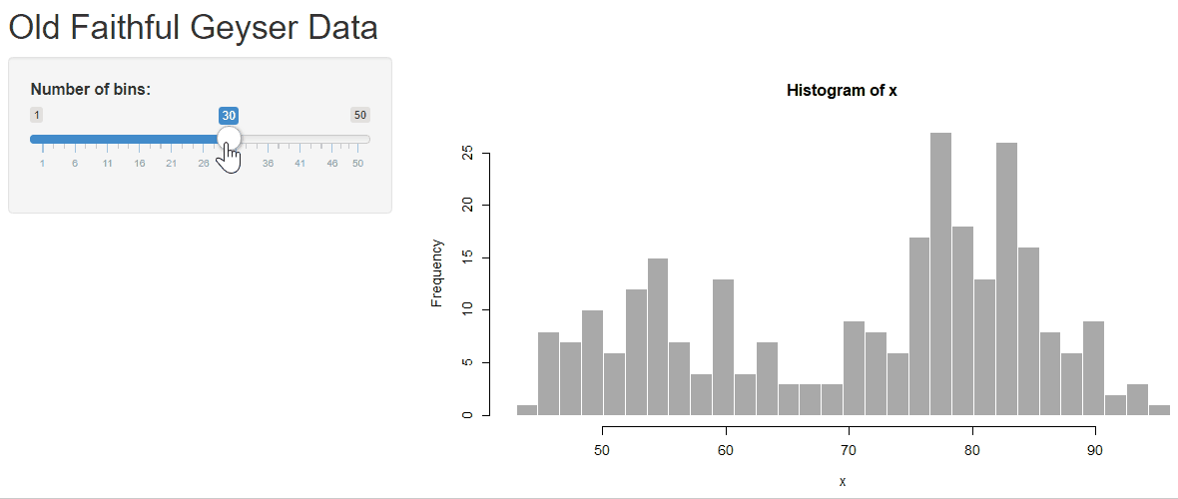
Old Faithful Example - running the app
# Run the application
shinyApp(ui = ui, server = server)

Slide 13
Sharing/Deploying Shiny Apps
Running Locally
The easiest way to share a Shiny app is by sharing the code (e.g. on GitHub). These can then be downloaded and run locally.
Running Online
If you want to make your Shiny app available as a web app online you will need a Shiny server:
You can deploy to https://www.shinyapps.io/ for free
If you have a web server, you can host your own Shiny server
UoG Psychology Department has a Shiny server

